Slide 1


Slide 2
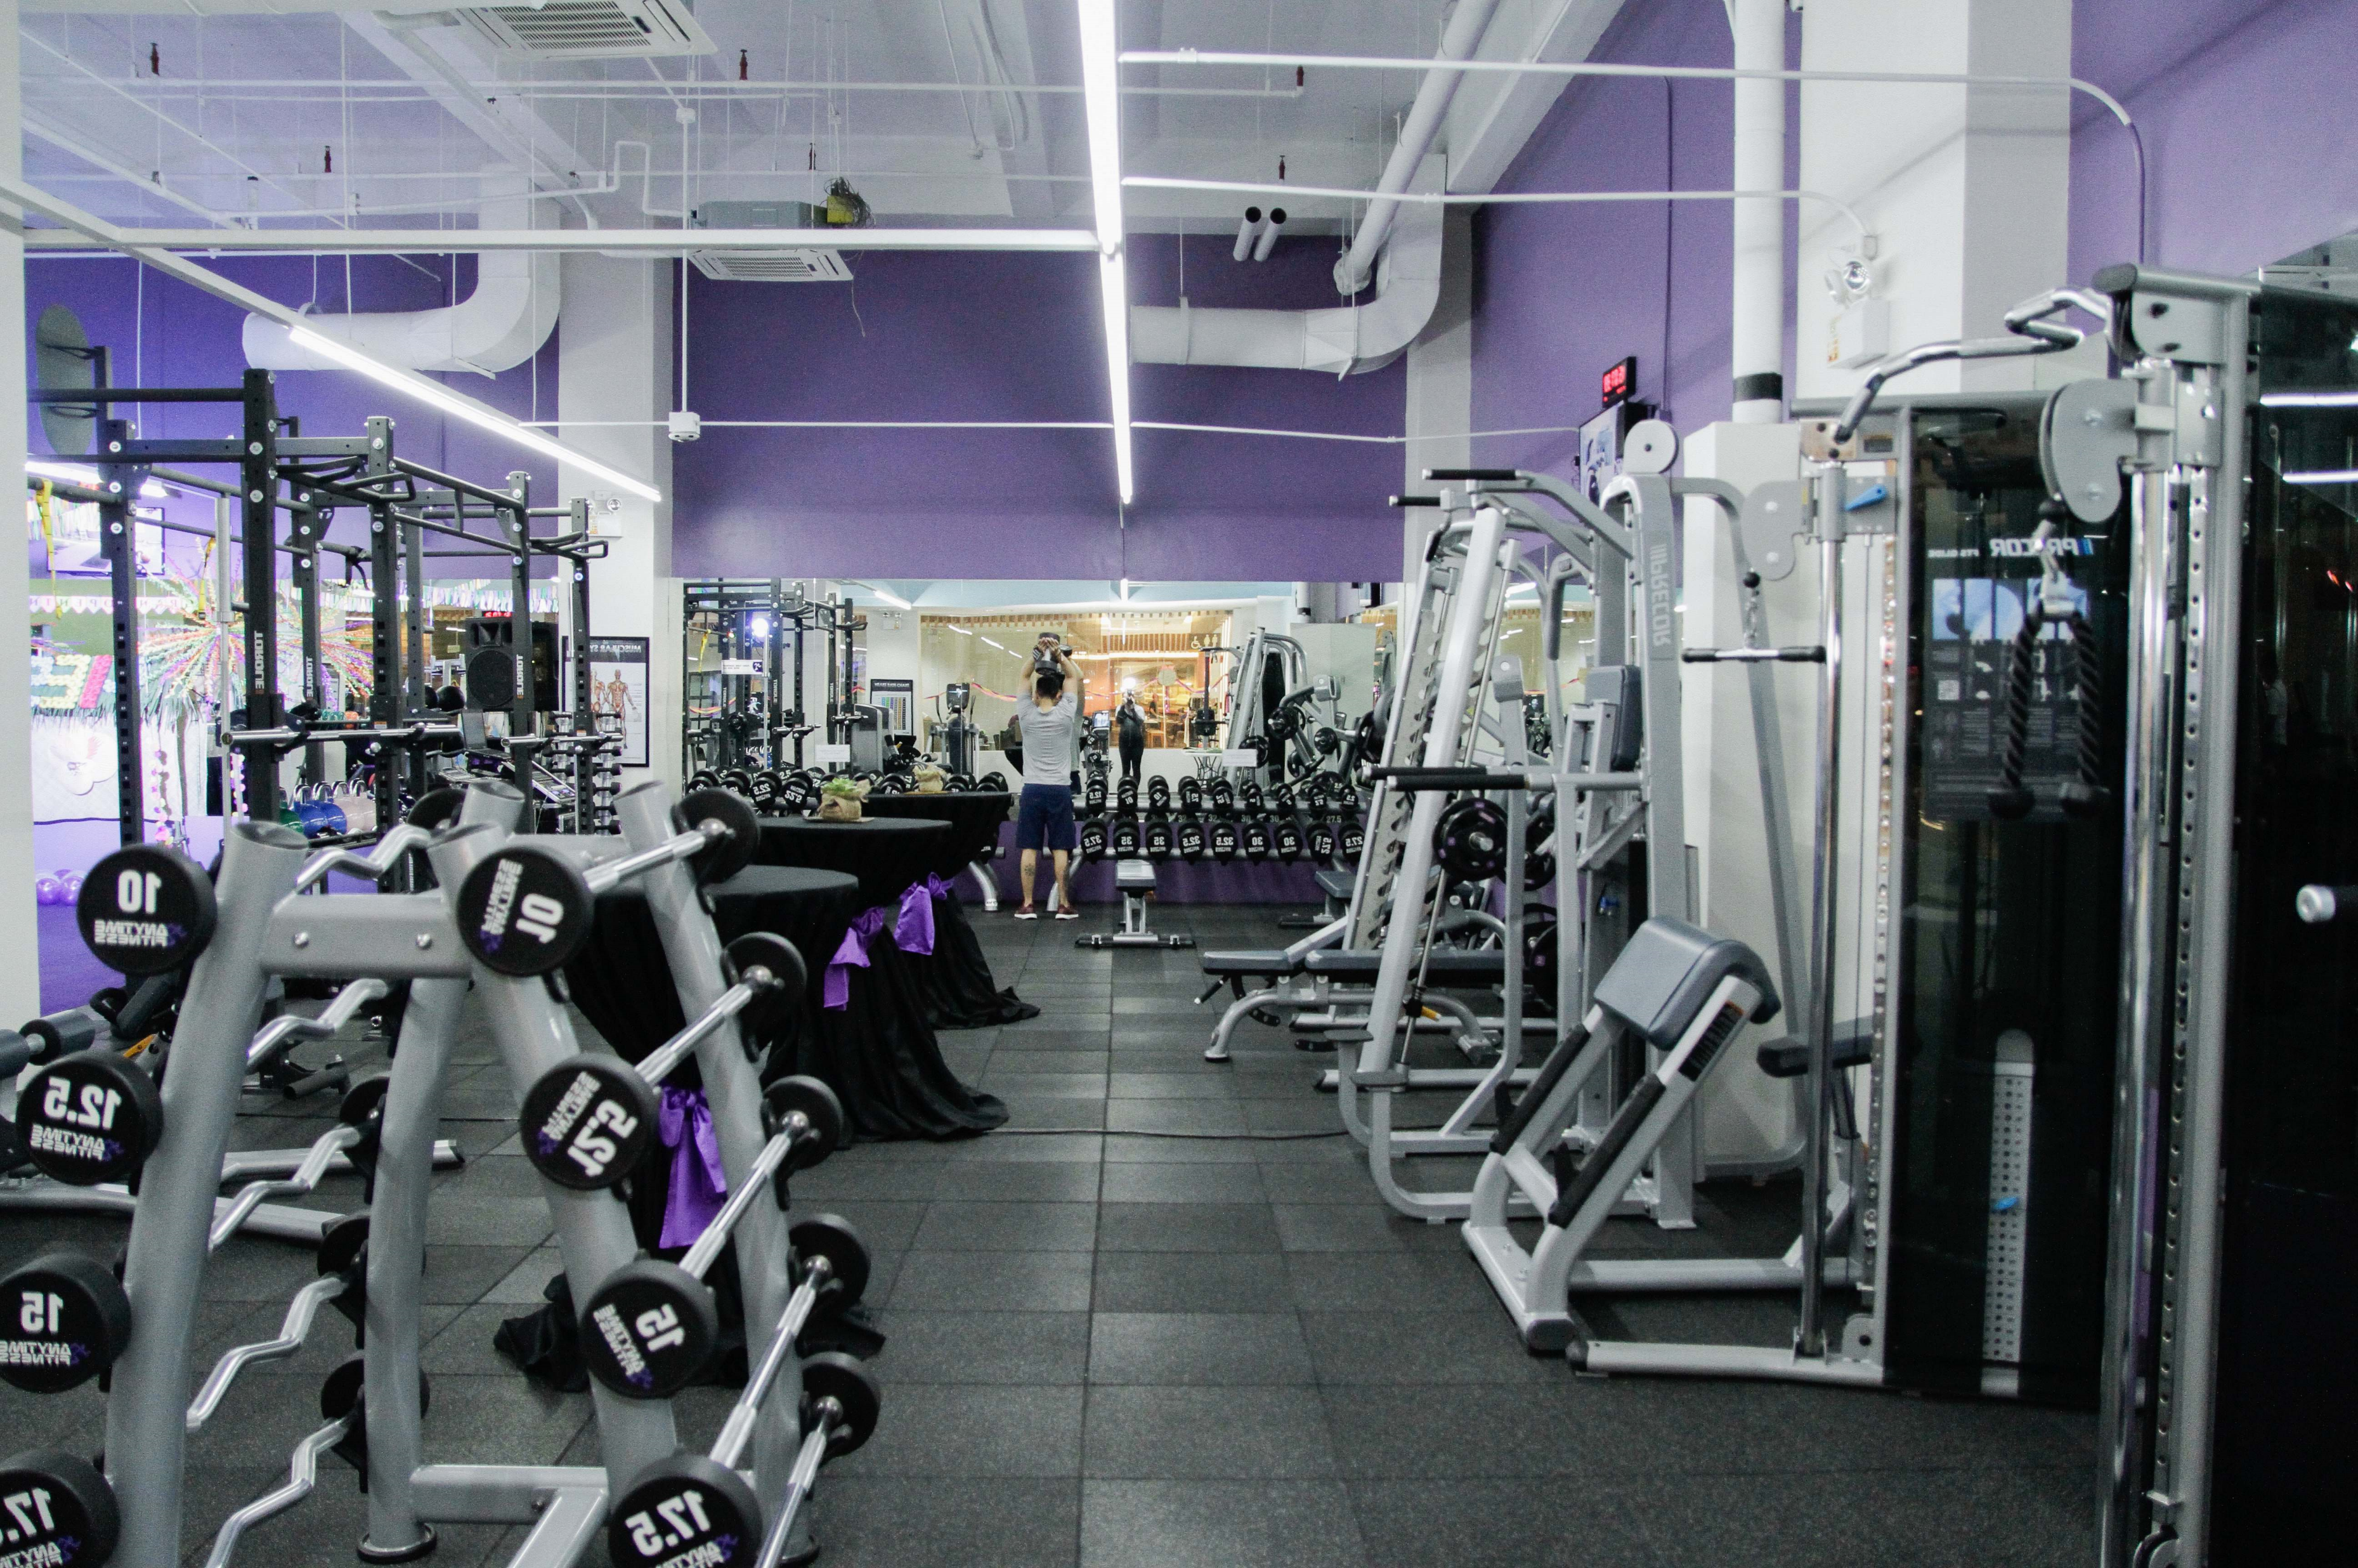
The Project involves designing the database schema, creating tables and populating them with the sample data.
Additionally, it includes writing SQL queries to perform various operations like fetching members details, tracking facility usage, managing subscriptions and analyzing trainer assignments.
Overall, the database system facilities efficient management and tracking of gym-related activities for better organization and service delivery.

Slide 3
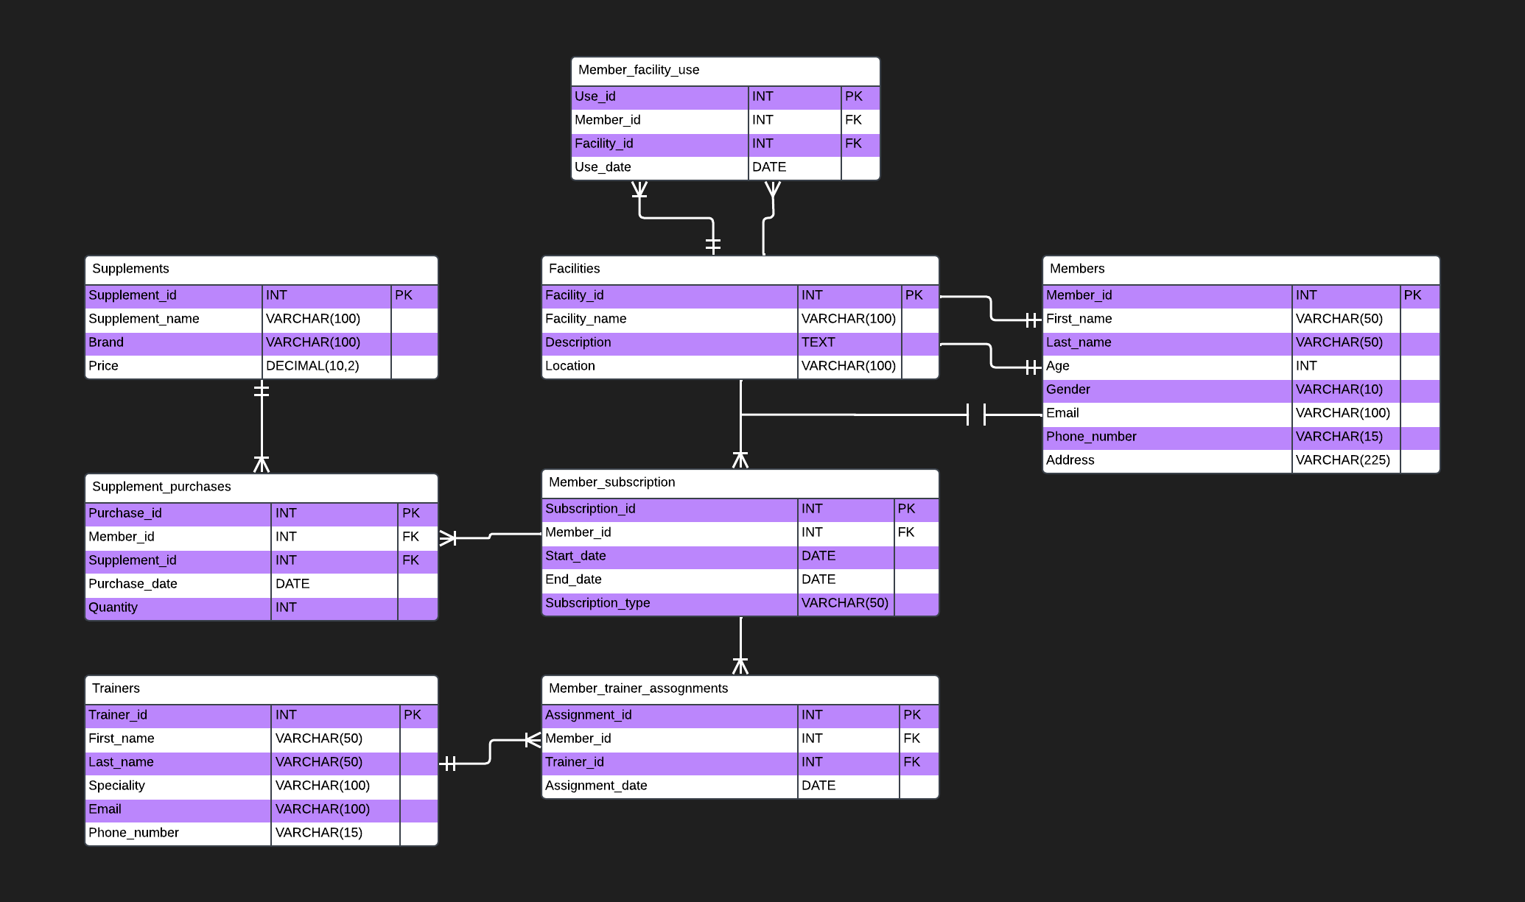

Slide 4
STRUCTURE OF THE TABLE
Field | Type | NULL | Key
member_id | int | NO | PRI
first_name | varchar(50) | YES
last_name | varchar(50) | YES
age | int | YES
gender | varchar(10) | YES
email | varchar(100) | YES
phone_number | varchar(15) | YES
address | varchar(255) | YES
Syntax : desc members;

Slide 5
Field | Type | NULL | Key
trainer_id | int | NO | PRI
first_name | varchar(50) | YES
last_name | varchar(50) | YES
specialty | varchar(100) | YES
email | varchar(100) | YES
phone_number | varchar(15) | YES
Syntax : desc trainers;

Slide 6
Field | Type | NULL | Key
supplement_id | int | NO | PRI
supplement_name | varchar(100) | YES
brand | varchar(100) | YES
price | decimal(10,2) | YES
Syntax : desc supplement;

Slide 7
Field | Type | NULL | Key
facility_id | int | NO | PRI
facility_name | varchar(100) | YES
description | text | YES
location | varchar(100) | YES
Syntax : desc facility;

Slide 8
Field | Type | NULL | Key
subscription_id | int | NO | PRI
member_id | int | YES | MUL
start_date | date | YES
end_date | date | YES
subscription_type | varchar(50) | YES
Syntax : desc member_Subscriptions;

Slide 9
Field | Type | NULL | Key
purchase_id | int | NO | PRI
member_id | int | YES | MUL
supplement_id | int | YES | MUL
purchase_date | date | YES
quantity | int | YES
Syntax : desc supplement_Purchases;

Slide 10
Field | Type | NULL | Key
assignment_id | int | NO | PRI
member_id | int | YES | MUL
trainer_id | int | YES | MUL
assignment_date | date | YES
Syntax : desc Member_Trainer_Assignments;

Slide 11
Field | Type | NULL | Key
use_id | int | NO | PRI
member_id | int | YES | MUL
facility_id | int | YES | MUL
use_date | date | YES
Syntax : desc Member_Facility_Use;

Slide 12
CONTENTS OF THE TABLE
Member_id | First-name | Last-name | Age | Gender | Email | Number | Address
1 | Aarav | Sharma | 28 | Male | aarav.sharma@example.com | 9876543210 | 123 Main St, Delhi
2 | Aditi | Patel | 32 | Female | aditi.patel@example.com | 9876543211 | 456 Elm St, Mumbai
3 | Arjun | Singh | 30 | Male | arjun.singh@example.com | 9876543212 | 789 Oak St, Kolkata
4 | Ayesha | Khan | 26 | Female | ayesha.khan@example.com | 9876543213 | 456 Pine St, Chennai
5 | Amit | Gupta | 29 | Male | amit.gupta@example.com | 9876543214 | 789 Maple St, Bangalore
6 | Divya | Sharma | 27 | Female | divya.sharma@example.com | 9876543215 | 123 Cherry St, Hyderabad
7 | Rohan | Kumar | 31 | Male | rohan.kumar@example.com | 9876543216 | 456 Walnut St, Pune
8 | Neha | Jain | 25 | Female | neha.jain@example.com | 9876543217 | 789 Birch St, Jaipur
9 | Vivek | Verma | 33 | Male | vivek.verma@example.com | 9876543218 | 123 Spruce St, Ahmedabad
10 | Priya | Reddy | 28 | Female | priya.reddy@example.com | 9876543219 | 456 Cedar St, Lucknow
Syntax : select * from members;

Slide 13
Trainer | First-name | Last-name | Specility | Email | Number
1 | Amit | Sharma | Yoga | amit.sharma@example.com | 9876543210
2 | Neha | Patel | Aerobics | neha.patel@example.com | 9876543211
3 | Raj | Singh | Weightlifting | raj.singh@example.com | 9876543212
4 | Priya | Kumar | Zumba | priya.kumar@example.com | 9876543213
5 | Rahul | Gupta | Pilates | rahul.gupta@example.com | 9876543214
Syntax : select * from trainer;

Slide 14
Supplement_id | Supplement_name | Brand | Price
1 | Protein Powder | MuscleTech | 29.99
2 | Creatine Monohydrate | Optimum Nutrition | 19.99
3 | Ashwagandha | Himalaya | 15.99
4 | Turmeric | Organic India | 10.50
5 | Omega-3 Fish Oil | Now Foods | 20.75
6 | Multivitamin | MuscleBlaze | 25.00
7 | Whey Protein Isolate | MyProtein | 34.99
8 | BCAA | Optimum Nutrition | 29.95
9 | Glutamine | Dymatize | 22.50
10 | Creatine HCL | Cellucor | 27.25
Syntax: select * from supplement;

Slide 15
Facility_id | Facility_name | Description | location
1 | Cardio Area | Contains treadmills, ellipticals, and stationary bikes. | First Floor
2 | Weight Room | Equipped with free weights and weightlifting machines. | Second Floor
3 | Yoga Studio | Dedicated space for yoga classes. | Third Floor
4 | Swimming Pool | Indoor heated pool for swimming workouts. | Ground Floor
5 | Group Fitness Studio | Space for group fitness classes such as Zumba and aerobics. | Basement
Syntax : select * from facilities;

Slide 16
Subscription_id | Member_id | start_date | End_date | Subscription_type
1 | 1 | 2024-01-01 | 2024-12-31 | Gold
2 | 2 | 2024-02-01 | 2024-07-31 | Silver
3 | 3 | 2024-03-15 | 2024-06-30 | Bronze
4 | 4 | 2024-01-15 | 2024-12-15 | Gold
5 | 5 | 2024-02-20 | 2024-08-20 | Silver
6 | 6 | 2024-04-05 | 2024-09-30 | Bronze
7 | 7 | 2024-03-10 | 2024-10-10 | Gold
8 | 8 | 2024-01-05 | 2024-12-05 | Silver
9 | 9 | 2024-02-12 | 2024-07-12 | Bronze
10 | 10 | 2024-05-20 | 2024-11-20 | Gold
Syntax : select * from member_Subscriptions;

Slide 17
Purchase_id | Member_id | Supplement_id | Purchase_date | Quantity
1 | 1 | 1 | 2024-02-10 | 1
2 | 2 | 2 | 2024-02-11 | 2
3 | 3 | 3 | 2024-02-12 | 1
4 | 4 | 4 | 2024-02-13 | 3
5 | 5 | 5 | 2024-02-14 | 1
6 | 6 | 6 | 2024-02-15 | 2
7 | 7 | 7 | 2024-02-16 | 1
8 | 8 | 8 | 2024-02-17 | 2
9 | 9 | 9 | 2024-02-18 | 1
10 | 10 | 10 | 2024-02-19 | 3
Syntax : select * from supplement_Purchases;

Slide 18
Assignment_id | Member_id | Trainer_id | Assignment_date
1 | 1 | 1 | 2024-02-10
2 | 2 | 2 | 2024-02-11
3 | 3 | 3 | 2024-02-12
4 | 4 | 4 | 2024-02-13
5 | 5 | 5 | 2024-02-14
6 | 6 | 1 | 2024-02-15
7 | 7 | 2 | 2024-02-16
8 | 8 | 3 | 2024-02-17
9 | 9 | 4 | 2024-02-18
10 | 10 | 5 | 2024-02-19
Syntax : select * from Member_Trainer_Assignments;

Slide 19
User_id | Member_id | Facility_id | Use_date
1 | 1 | 1 | 2024-02-12
2 | 2 | 2 | 2024-02-13
3 | 3 | 3 | 2024-02-14
4 | 4 | 4 | 2024-02-15
5 | 5 | 5 | 2024-02-16
6 | 6 | 1 | 2024-02-17
7 | 7 | 2 | 2024-02-18
8 | 8 | 3 | 2024-02-19
9 | 9 | 4 | 2024-02-20
10 | 10 | 5 | 2024-02-21
Syntax : select * from Member_Facility_Use;

Slide 20
SUB-QUARIES

Slide 21
Find Members with Gold Memberships:
Member_id | First_name | Last_name | Age | Gender | Email | Phone_ number | Address
1 | Aarav | Sharma | 28 | Male | aarav.sharma@example.com | 9876543210 | 123 Main St, Delhi
4 | Ayesha | Khan | 26 | Female | ayesha.khan@example.com | 9876543213 | 456 Pine St, Chennai
7 | Rohan | Kumar | 31 | Male | rohan.kumar@example.com | 9876543216 | 456 Walnut St, Pune
10 | Priya | Reddy | 28 | Female | priya.reddy@example.com | 9876543219 | 456 Cedar St, Lucknow
SYNTAX:
SELECT *
FROM Members
WHERE member_id IN (
SELECT member_id
FROM Member_Subscriptions
WHERE subscription_type = 'Gold’ );

Slide 22
Find Trainers Who Train Male Members:
Trainer_id | First_name | Last_name | Specility | Email | Phone_number
1 | Amit | Sharma | Yoga | amit.sharma@example.com | 9876543210
3 | Raj | Singh | Weightlifting | raj.singh@example.com | 9876543212
5 | Rahul | Gupta | Pilates | rahul.gupta@example.com | 9876543214
2 | Neha | Patel | Aerobics | neha.patel@example.com | 9876543211
4 | Priya | Kumar | Zumba | priya.kumar@example.com | 9876543213
SYNTAX:
SELECT *
FROM Trainers
WHERE trainer_id IN (
SELECT trainer_id
FROM Member_Trainer_Assignments
WHERE member_id IN (
SELECT member_id
FROM Members
WHERE gender = 'Male’
));

Slide 23
Find Members Who Purchased Supplements That Cost More Than $20:
Member_id | First_name | Last_name | Age | Gender | Email | Phone_ number | Address
1 | Aarav | Sharma | 28 | Male | aarav.sharma@example.com | 9876543210 | 123 Main St, Delhi
5 | Amit | Gupta | 29 | Male | amit.gupta@example.com | 9876543214 | 789 Maple St, Bangalore
6 | Divya | Sharma | 27 | Female | divya.sharma@example.com | 9876543215 | 123 Cherry St, Hyderabad
7 | Rohan | Kumar | 31 | Male | rohan.kumar@example.com | 9876543216 | 456 Walnut St, Pune
8 | Neha | Jain | 25 | Female | neha.jain@example.com | 9876543217 | 789 Birch St, Jaipur
9 | Vivek | Verma | 33 | Male | vivek.verma@example.com | 9876543218 | 123 Spruce St, Ahmedabad
10 | Priya | Reddy | 28 | Female | priya.reddy@example.com | 9876543219 | 456 Cedar St, Lucknow
SYNTAX:
SELECT *
FROM Members
WHERE member_id IN (
SELECT member_id
FROM Supplement_Purchases
WHERE supplement_id IN (
SELECT supplement_id
FROM Supplements
WHERE price > 20.00 ));

Slide 24
Find Members Who Purchased Supplements With Quantity More Than 1:
Member_id | First_name | Last_name | Age | Gender | Email | Phone_ number | Address
2 | Aditi | Patel | 32 | Female | aditi.patel@example.com | 9876543211 | 456 Elm St, Mumbai
4 | Ayesha | Khan | 26 | Female | ayesha.khan@example.com | 9876543213 | 456 Pine St, Chennai
6 | Divya | Sharma | 27 | Female | divya.sharma@example.com | 9876543215 | 123 Cherry St, Hyderabad
8 | Neha | Jain | 25 | Female | neha.jain@example.com | 9876543217 | 789 Birch St, Jaipur
10 | Priya | Reddy | 28 | Female | priya.reddy@example.com | 9876543219 | 456 Cedar St, Lucknow
SYNTAX:
SELECT *
FROM Members
WHERE member_id IN (
SELECT member_id
FROM Supplement_Purchases
WHERE quantity > 1);

Slide 25
JOINS

Slide 26
Subquery with Inner Join: Find members who have Gold subscriptions and their assigned trainers.
Member_id | First_name | Last_name | Age | Gender | Email | Phone_ number | Address | Subscription_id
1 | Aarav | Sharma | 28 | Male | aarav.sharma@example.com | 9876543210 | 123 Main St, Delhi | 1 | 1
4 | Ayesha | Khan | 26 | Female | ayesha.khan@example.com | 9876543213 | 456 Pine St, Chennai | 4 | 4
7 | Rohan | Kumar | 31 | Male | rohan.kumar@example.com | 9876543216 | 456 Walnut St, Pune | 7 | 2
10 | Priya | Reddy | 28 | Female | priya.reddy@example.com | 9876543219 | 456 Cedar St, Lucknow | 10 | 5
SYNTAX:
SELECT *
FROM Members
INNER JOIN (
SELECT Member_Subscriptions.member_id, trainer_id
FROM Member_Subscriptions
JOIN Member_Trainer_Assignments ON Member_Subscriptions.member_id = Member_Trainer_Assignments.member_id
WHERE subscription_type = 'Gold’
) AS GoldMembers ON Members.member_id = GoldMembers.member_id;

Slide 27
Subquery with Left Join and Conditional Aggregation: Find the total number of supplement purchases made by each member, including members who haven't made any purchases.
Member_id | First_name | Last_name | Total_purchase
1 | Aarav | Sharma | 1
2 | Aditi | Patel | 1
3 | Arjun | Singh | 1
4 | Ayesha | Khan | 1
5 | Amit | Gupta | 1
6 | Divya | Sharma | 1
7 | Rohan | Kumar | 1
8 | Neha | Jain | 1
9 | Vivek | Verma | 1
10 | Priya | Reddy | 1
SYNTAX:
SELECT Members.member_id, first_name, last_name, COALESCE(total_purchases, 0) AS total_purchases
FROM Members
LEFT JOIN (
SELECT member_id, COUNT(*) AS total_purchases
FROM Supplement_Purchases
GROUP BY member_id
) AS MemberPurchases ON Members.member_id = MemberPurchases.member_id;

Slide 28
Subquery with Right Join and Subquery in the SELECT Clause:
Find trainers along with the total number of assigned members each trainer has.
Trainer_id | First_name | Last_name | Specility | Email | Phone_number | Total_assigned_members
1 | Amit | Sharma | Yoga | amit.sharma@example.com | 9876543210 | 2
2 | Neha | Patel | Aerobics | neha.patel@example.com | 9876543211 | 2
3 | Raj | Singh | Weightlifting | raj.singh@example.com | 9876543212 | 2
4 | Priya | Kumar | Zumba | priya.kumar@example.com | 9876543213 | 2
5 | Rahul | Gupta | Pilates | rahul.gupta@example.com | 9876543214 | 2
SYNTAX:
SELECT Trainers.*, COALESCE(total_assigned_members, 0) AS total_assigned_members
FROM Trainers
RIGHT JOIN (
SELECT trainer_id, COUNT(member_id) AS total_assigned_members
FROM Member_Trainer_Assignments
GROUP BY trainer_id
) AS AssignedMembersCount ON Trainers.trainer_id = AssignedMembersCount.trainer_id;

Slide 29
Subquery with Inner Join and Subquery in the WHERE Clause:
Find members who have used facilities today and their subscription details.
Member_id | First_name | Last_name | Age | Gender | Email | Phone_number | Address | Use_id | Member_id | Facility_id | Use_date
8 | Neha | Jain | 25 | Female | neha.jain@example.com | 9876543217 | 789 Birch St, Jaipur | 8 | 8 | 3 | 2024-02-19
SYNTAX:
SELECT *
FROM Members
INNER JOIN Member_Facility_Use ON Members.member_id = Member_Facility_Use.member_id
WHERE Member_Facility_Use.use_date = CURDATE();

Slide 30
THANKYOU
- Rohit Bhagat

